Slide 1
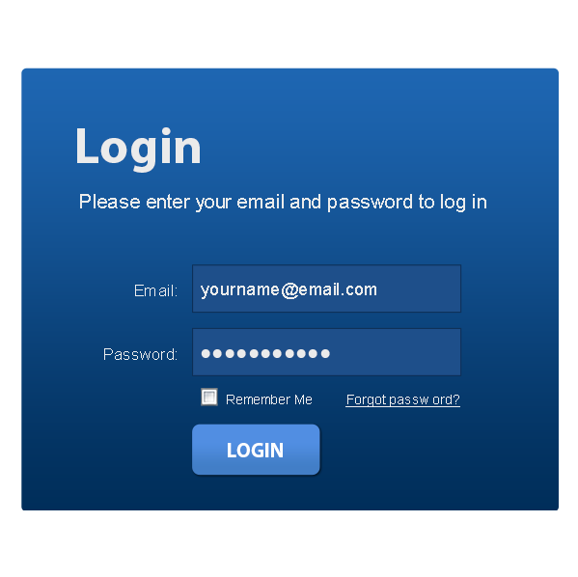
What are online cookies, web browsers and antivirus software

Slide 2
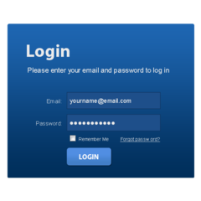
What does browsing mean and what is my browser?
Browsing usually means searching the internet for facts, things and knowledge. A web browser is a programme that helps you to search the internet.
The internet is often called the World Wide Web.

Slide 3
What does browsing mean and what is my browser?
Some examples of web browsers are Microsoft Edge, Google Chrome, Mozilla Firefox and Safari.
We also have a thing called a search engine, which we use to search for anything we want or need online. Google one of the most common search engine.

Slide 4
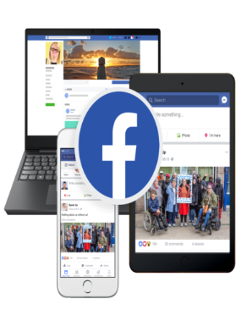
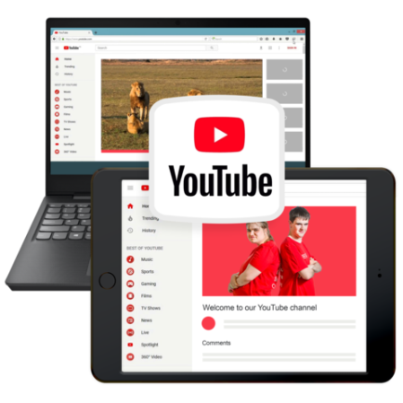
What is a Search Engine?
A search engine is a very big library of information that anyone with the internet can use
In order to use a search engine you will first need to open your web browser
The biggest search engine is Google. Others include Yahoo, Bing, Facebook and YouTube, to name but a few

Slide 5
What is a trusted internet antivirus software?
An antivirus software or internet security protects you from online threats, such as viruses and other malware.
Do not click on anything you are suspicious or worried about or anything you do not know. They could contain malware, which can harm your computer or get to your personal information.

Slide 6
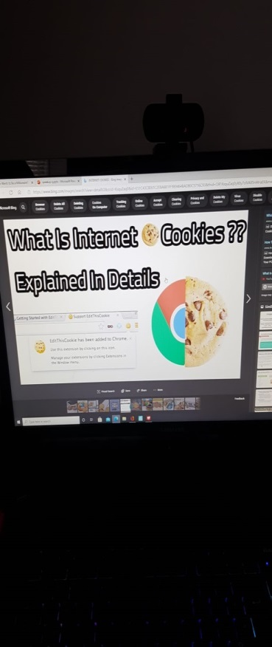
What are Cookies?
Necessary cookies help a website to work
Cookies that improve websites by collecting and reporting information are called Analytical cookies
Cookies should collect information in a way that doesn’t tell who you are.
User Experience Cookies help to improve your experience of using a website.

Slide 7
So what have we learnt about Cookies
If you are watching the film and reading through these presentations, now talk together about that you have learned about Cookies.

